Slide 1

Quantum Cloud Computing
Johannes Otterbach
TU Kaiserslautern
January 22, 2018

Slide 2
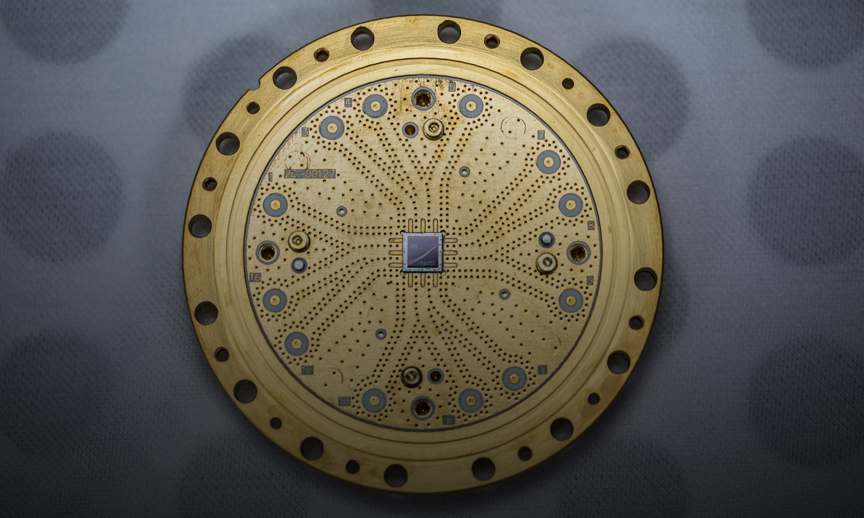
Rigetti 8-Qubit Quantum Processor
Notes:
But what you need to tackle them is real quantum hardware. Our core innovation at Rigetti has been to build a chip architecture that can scale, that is, to turn qubits into quantum integrated circuits that enable the integration of more and more qubits onto a single chip over time.
Over the past year and a half, we’ve doubled the number of qubits on our chips every six months. This is one of our 8-qubit processors, one of the world’s very first true quantum computers.
In June, we announced the opening of our captive foundry – Fab-1 – the world’s first commercial quantum integrated circuit facility. Using Fab-1 we are able to run a cycle time of three weeks between a design innovation, and having a manufactured chip to test in the lab – that’s unheard of in this industry.
With the capability our fab has unlocked, we have begun the design and manufacturing of 20 qubit chips. We will be testing those in the coming weeks. In the first half of next year, we will begin testing chips at the supremacy scale, which is around 60 qubits.

Slide 3
Rigetti 8-Qubit Quantum Processor
> Scalable Gate-model Quantum Processors > Superconducting Microwave Circuits
> Focus on near-term applications > Quantum/Classical Hybrid Algorithms
> Build towards fault-tolerance
> Access over the cloud
> Quantum computers as co-processors
Notes:
But what you need to tackle them is real quantum hardware. Our core innovation at Rigetti has been to build a chip architecture that can scale, that is, to turn qubits into quantum integrated circuits that enable the integration of more and more qubits onto a single chip over time.
Over the past year and a half, we’ve doubled the number of qubits on our chips every six months. This is one of our 8-qubit processors, one of the world’s very first true quantum computers.
In June, we announced the opening of our captive foundry – Fab-1 – the world’s first commercial quantum integrated circuit facility. Using Fab-1 we are able to run a cycle time of three weeks between a design innovation, and having a manufactured chip to test in the lab – that’s unheard of in this industry.
With the capability our fab has unlocked, we have begun the design and manufacturing of 20 qubit chips. We will be testing those in the coming weeks. In the first half of next year, we will begin testing chips at the supremacy scale, which is around 60 qubits.

Slide 4

Rigetti 8-Qubit Quantum Processor
Founded in 2013 by Chad Rigetti
Fab-1: Fremont, CA
~100 Employees
Forest: Quantum computing over the cloud
Venture backed startup
R&D lab: Berkeley, CA
Full-stack scalable superconducting qubits
30-qubit Quantum Virtual MachineTM
Notes:
Venture-backed quantum computing startup
Founded 2013 by Chad Rigetti
~90 employees
Berkeley: HQ, R&D, and Lab
Fremont: Fab-1
“Full stack” built on scalable superconducting qubits
Design, Fab, and System Integration
Software and Applications
Business Plan: Deliver quantum computing over the cloud
Focus on near-term applications and algorithms
Build toward fault tolerance in the long term
Developer of Forest
World’s best quantum programming and execution environment
Hybrid quantum/classical computing
30-qubit Quantum Virtual Machine simulator
Cloud access to 8-qubit systems today

Slide 5




Full Stack Quantum Computing
Quantum Processor
Hardware
Cloud based Quantum Operating System
Applications
Notes:
WHO WE ARE / FULLSTACK
Rigetti maintains a rapid design-fab-test cycle. It takes about 3 weeks from device design to fabricate, cool down, and test the chip. This iteration rate is highly unusual for the industry.

Slide 6
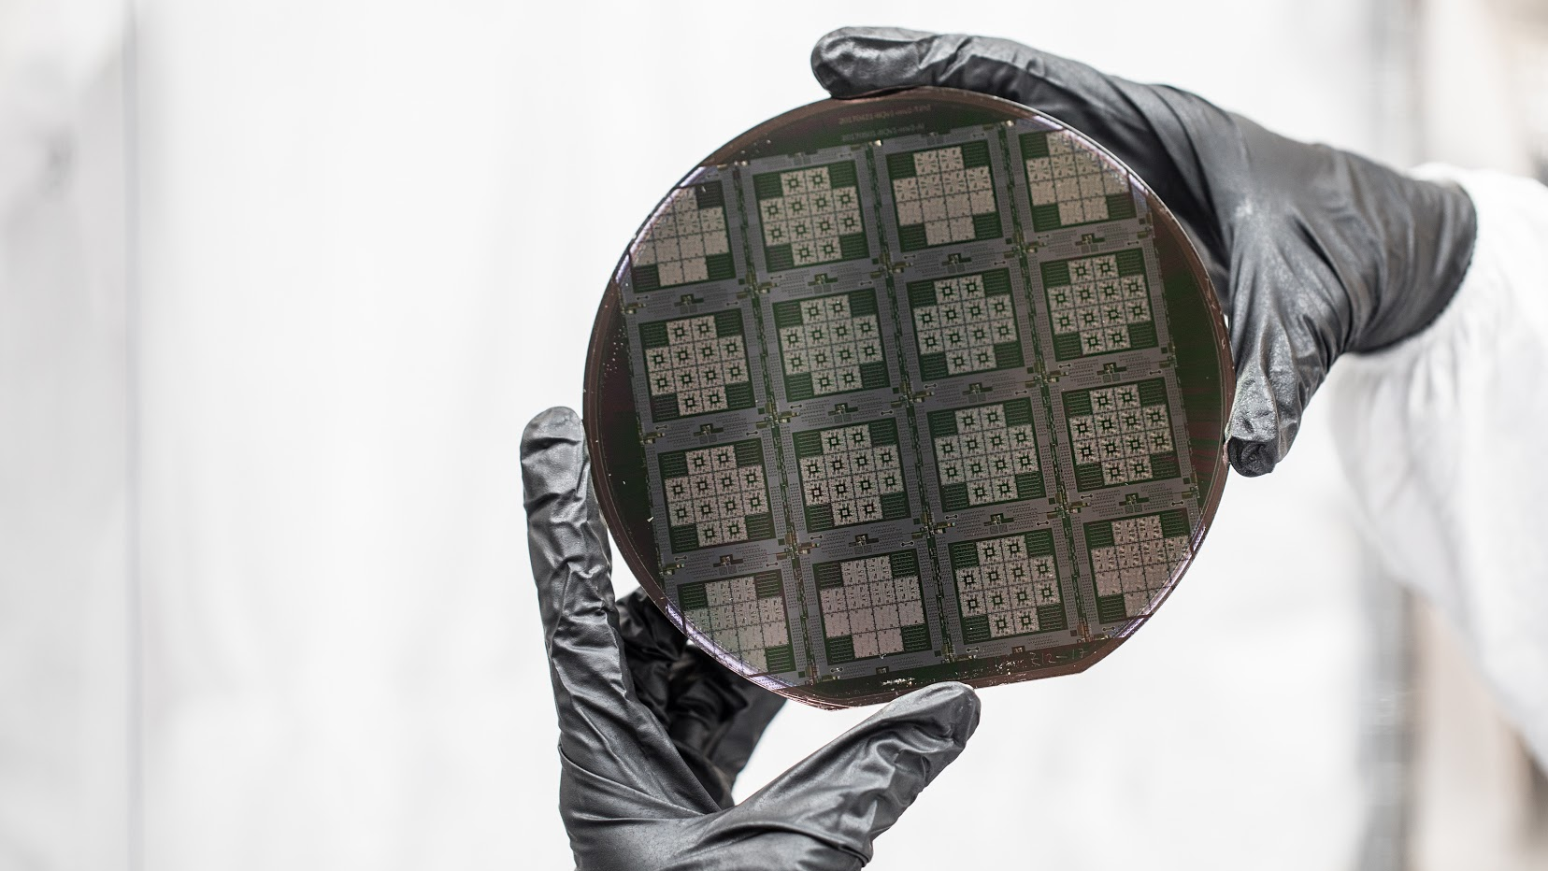

What do our Qubits look like ?
Superconducting circuits
Operated near absolute zero
Aluminum on silicon
Microwave signal delivery
Notes:
Superconducting definition-
Aluminum on silicon - the qubit is made of this. We use silicon to leverage the existing microchip industry and infrastructure
Microwave signal delivery - the way we excite our qubits, change the state of the qubit (0 to 1) using electromagnetic waves in the microwave frequency range

Slide 7
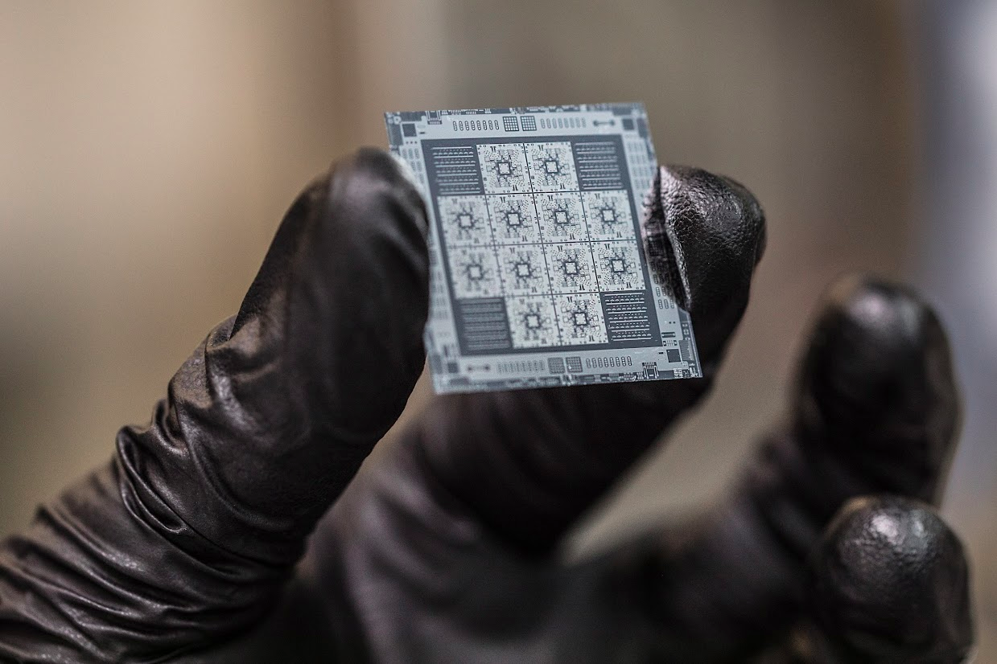
die
chip

Slide 8
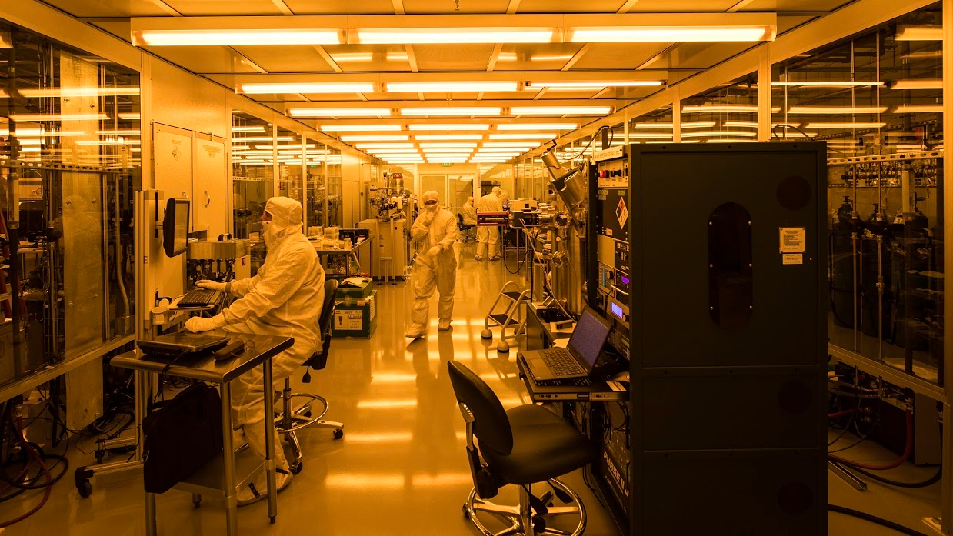
The world’s first dedicated quantum processor fab
Fremont, CA

Slide 9
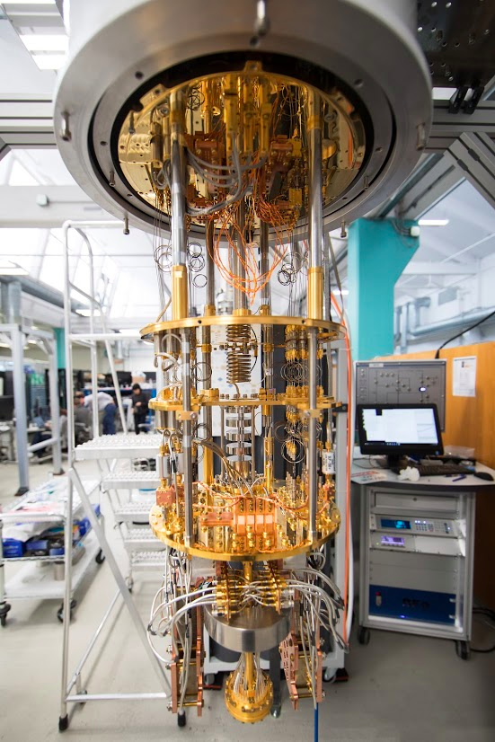
Signal Delivery
The Chip

Slide 10
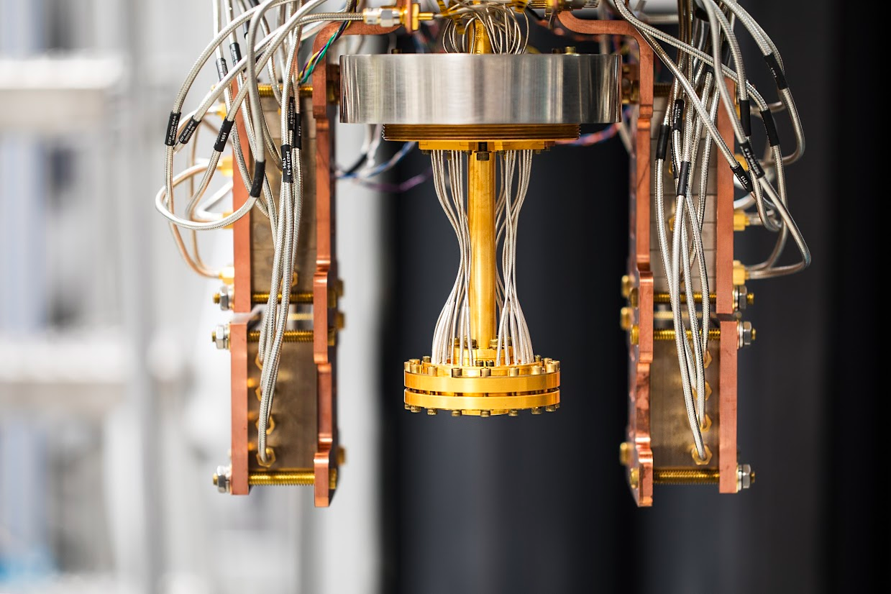
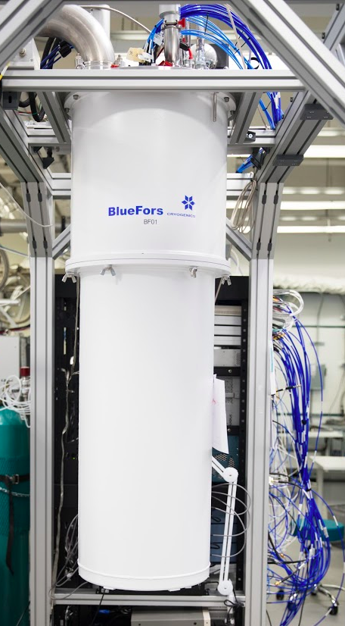
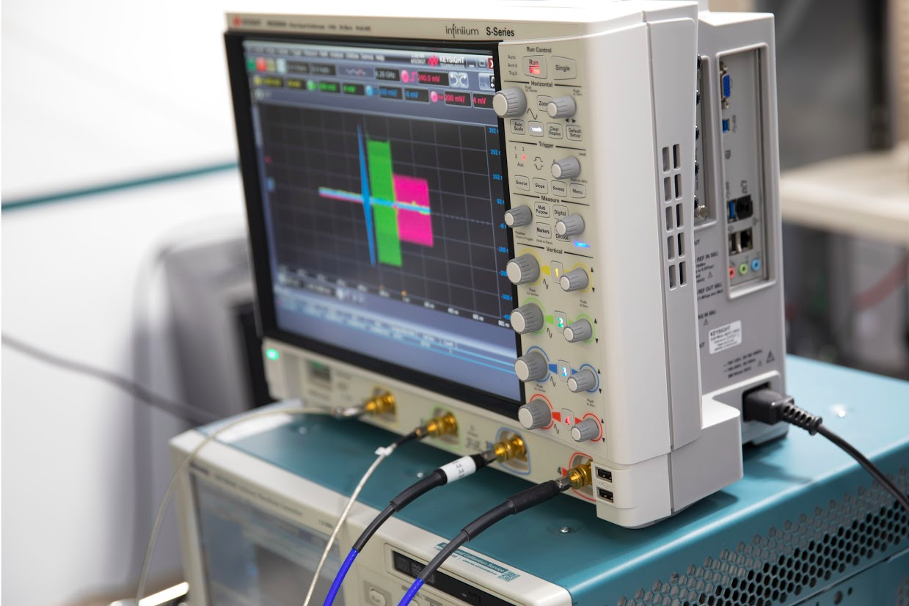
Superconducting quantum processors
> Packaging
> Cooling
> Control Electronics
Notes:
No change needed

Slide 11


FOREST: Tools for experimental quantum programming
forest.rigetti.com
> Write applications...
APPLICATIONS: Grove
Open-sourced on github under Apache v2.0 license
github.com/rigetticomputing/pyquil
github.com/rigetticomputing/grove
> using tools...
DEVELOPMENT: pyQuil
QUANTUM INSTRUCTION LANGUAGE: Quil
> that build quantum
programs...
Client
> that compile onto
quantum hardware...
Simulator in public-beta
Quantum HW
forest.rigetti.com
COMPILER
QUANTUM VIRTUAL MACHINE / QUANTUM COMPUTER
> that execute on a
real or virtual
quantum processor.
Server
Robert Smith, Michael Curtis, William Zeng. A Practical Quantum Instruction Set Architecture. arXiv:1608.03355

Slide 12
Quantum Algorithms
1990
2013
Simulating quantum systems
1981
Original proposal by Feynman:
Simulating physics with computers
“The physical world is quantum mechanical, and therefore the proper problem is the simulation of quantum physics.”
Notes:
Hybrid computing interplay to optimize over large data-sets
CPU is for hyper parameter optimization
QPU is for getting a better search direction/better gradient/ non-greedy function call/ over large data-set.

Slide 13
Quantum Algorithms
1990
1994
Shor’s factoring algorithm (Shor)
2013
1995
Phase Estimation (PE) introduced (Kitaev)
Simulating quantum systems
1997
Hamiltonian Simulation by PE (Lloyd)
2002
Map of fermions to paulis (Somma)
1981
Original proposal by Feynman:
Simulating physics with computers
“The physical world is quantum mechanical, and therefore the proper problem is the simulation of quantum physics.”
2005
Molecular ground states w/ PE (Aspuru-Guzik)
2010
H₂ ground state using simulated QC (Whitfield)
2013
Hybrid Quantum-Classical Algorithms VQE (McClean)
2015
Approximate Combinatorial Optimization (Farhi)
TODAY
Notes:
Hybrid computing interplay to optimize over large data-sets
CPU is for hyper parameter optimization
QPU is for getting a better search direction/better gradient/ non-greedy function call/ over large data-set.

Slide 14
Quantum Algorithms
1990
1994
Shor’s factoring algorithm (Shor)
2013
1995
Phase Estimation (PE) introduced (Kitaev)
1997
Hamiltonian Simulation by PE (Lloyd)
2013
Molecular ground states w/ VQE Implementation on a photonics processor (Peruzzo)
2002
Map of fermions to paulis (Somma)
2014
Quantum Combinatorial Optimization (QAOA) (Farhi), eg. MAX-CUT, MaxE3Lin2
2005
Molecular ground states w/ PE (Aspuru-Guzik)
2015
VQE + PE on superconducting qubits,
Small quantum machine learning examples
2010
H₂ ground state using simulated QC (Whitfield)
2016
Broader applications of VQE (Troyer, Rubin)
2013
Hybrid Quantum-Classical Algorithms VQE (McClean)
2017
Machine Learning (Aspuru-Guzik, Otterbach)
2015
Approximate Combinatorial Optimization (Farhi)
TODAY
TODAY
Simulating quantum systems
Notes:
Hybrid computing interplay to optimize over large data-sets
CPU is for hyper parameter optimization
QPU is for getting a better search direction/better gradient/ non-greedy function call/ over large data-set.

Slide 15

Transmons & 2-Qubit Gates

Slide 16
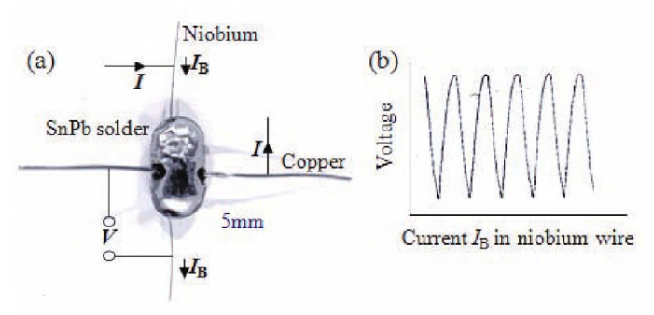
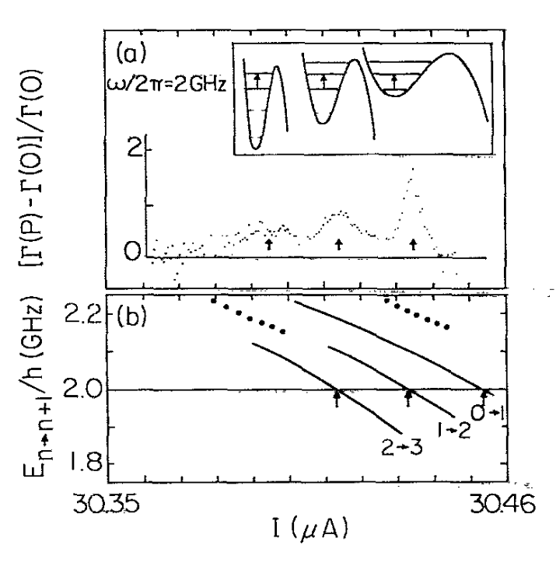
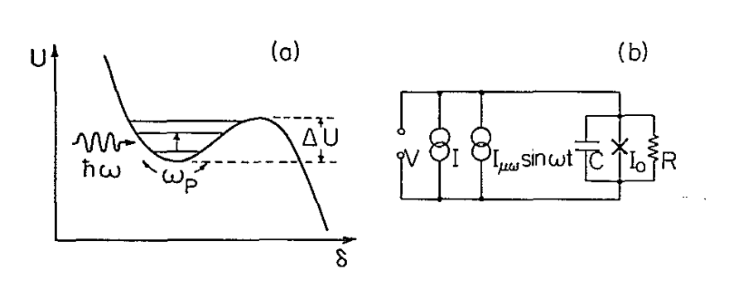
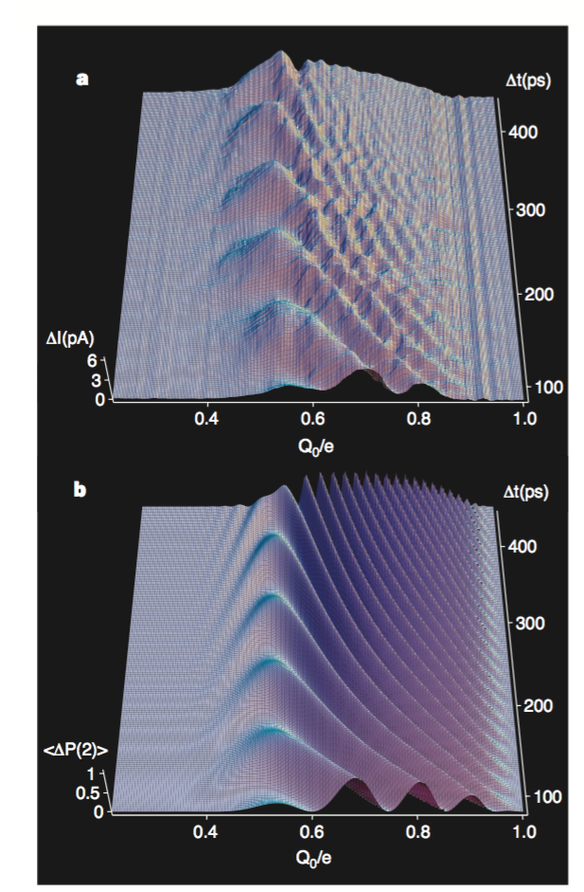
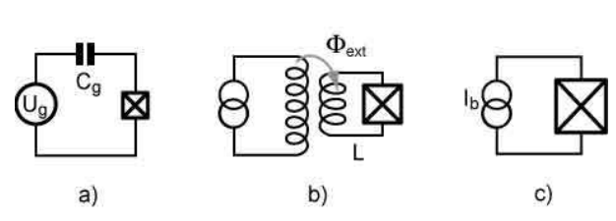
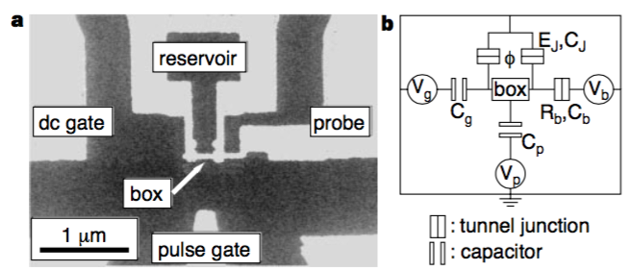
Early years of superconducting qubits
Josephson junctions
Macroscopic coherence
J. Clarke, 1966
J. Martinis, M. Devoret, J. Clarke, PRB, 1987
Coherent control
Qubit taxonomy
Charge
Flux
Phase
Y. Nakamura et al., Nature, 1999
M. Devoret, A. Wallraff, J. Martinis, arXiv:0411174 (2004)

Slide 17
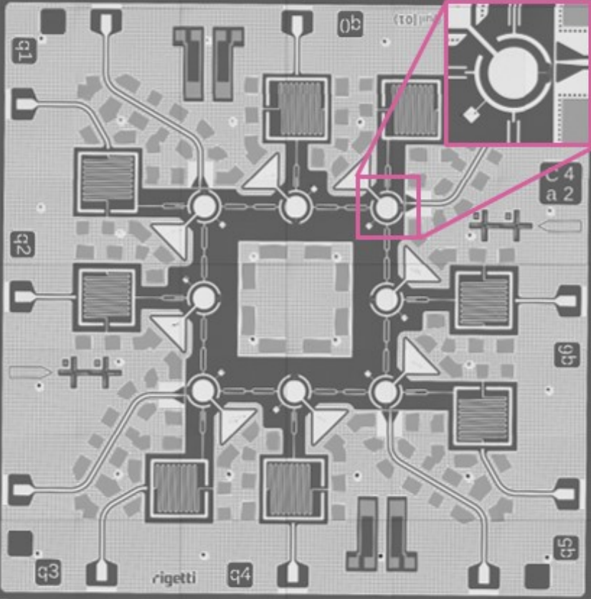
Our Implementation
Aluminum circuit on Silicon
Circuit Quantum Electrodynamics (cQED)
Superconducting circuits at very low temps (0.01 Kelvin)
Qubit = Circuit element made with Josephson Junctions (JJ’s)
Blais, cond-mat/0402216
Wallraff, cond-mat/0407325
5.5mm

Slide 18
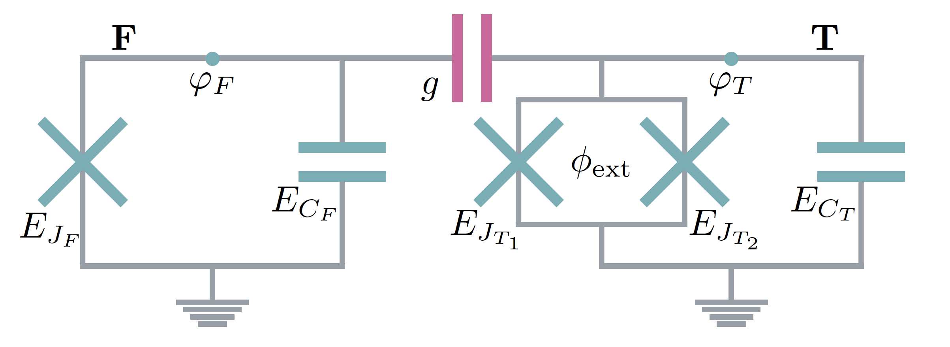

cQED - the transmon qubit(s)
Josephson Junction - Cooper Pair Box
Transmon regime:
JJ’s are nonlinear
Nonlinearity→two-level subspace→qubit
Qubits coupled to linear resonators for state readout
Jaynes-Cummings Hamiltonian: Atomic transition coupled to cavity mode
Two types of transmons: Fixed & Tunable
CPB

Slide 19
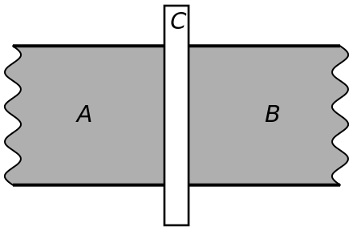
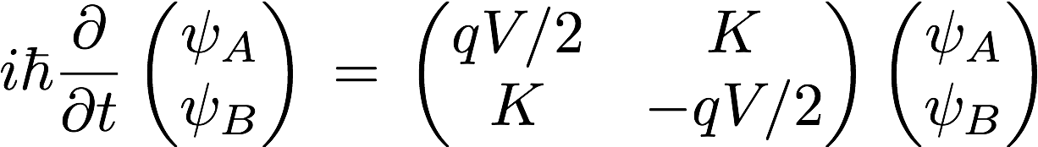
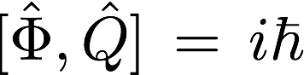
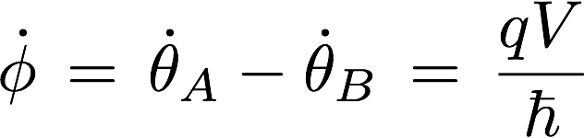
Josephson Effect
Fundamental commutation relation of cQED
Equations of Motion
Notes:
For certain phases there is no tunneling!

Slide 20
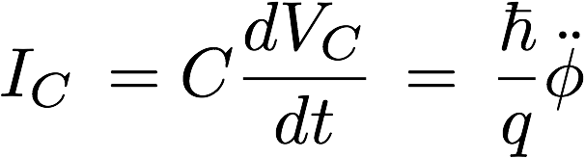
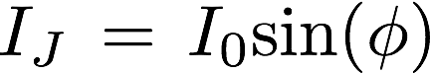
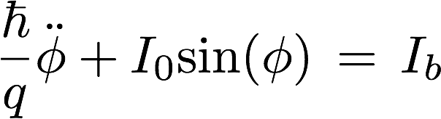
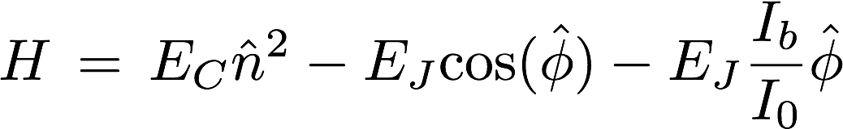
Fixed SC Qubit
Capacitor
Junction
Equation of motion
Using Lagrangian formalism and fundamental commutation relation to arrive at Hamiltonian

Slide 21
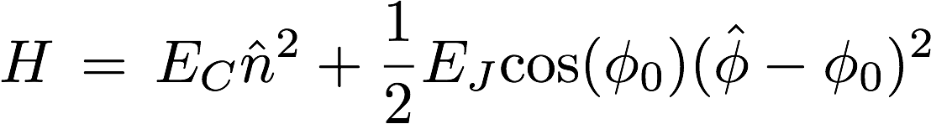
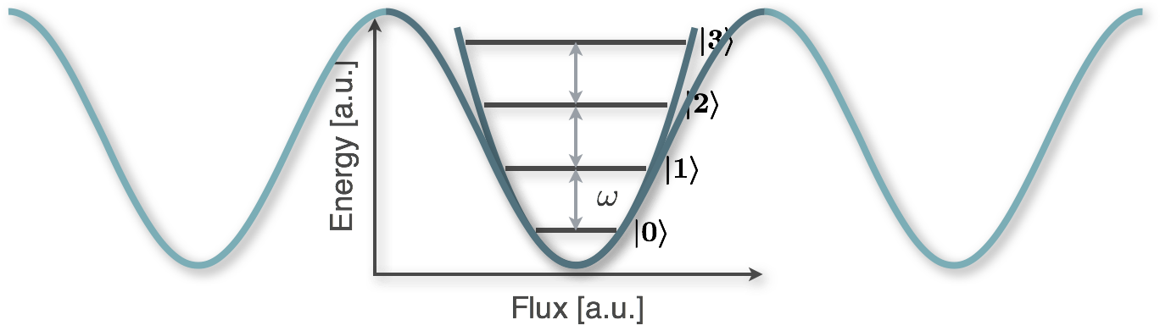
Washboard and SC-Qubits
Taylor expansion: Harmonic Oscillator

Slide 22
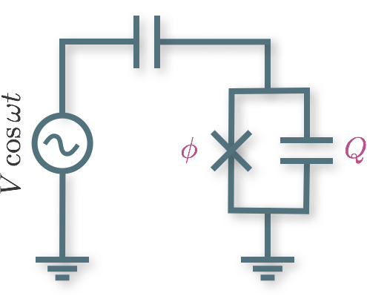
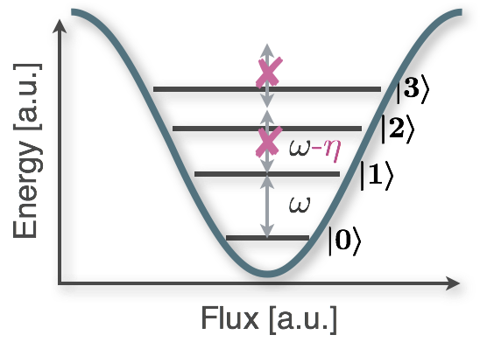
Washboard and SC-Qubits
Taylor expansion: Harmonic Oscillator
Higher order correction: Anharmonic spectrum
Ground- and 1st excited state form Qubit states
Transmon Regime

Slide 23
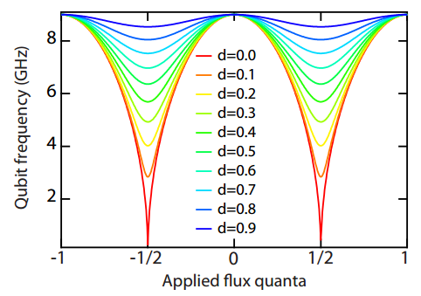
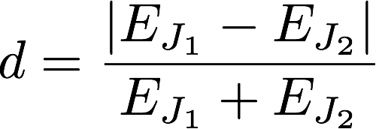
Tunable SC Qubit
Phase sensitive SQUID
Hamiltonian
Symmetric junctions: E_{J1} = E_{J2}
Phases cancel completely at 𝜱=𝜱₀/2
Asymmetric junctions: E_{J1} != E_{J2}
Phases cancel incompletely at 𝜱=𝜱₀/2
mage from M. Reed, Entanglement and Quantum Error Correction using Superconducting Qubits, 2013, arXiv:1311.6759

Slide 24
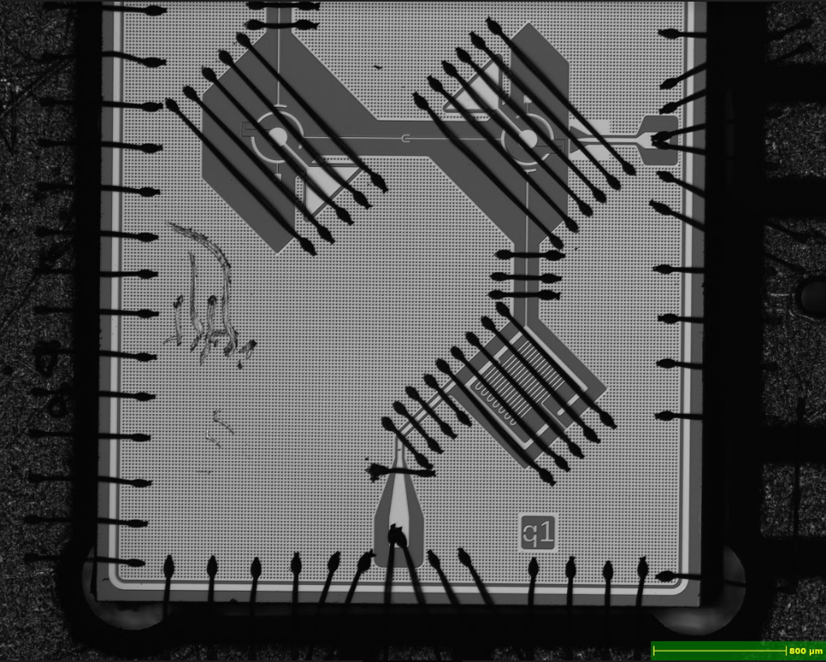


Experimental Device
Flux bias line (FBL)
Current
Tunable transmon
RF port
Josephson
Junctions
SQUID Loop
Notes:
Add picture of coil

Slide 25
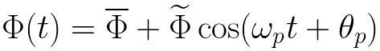
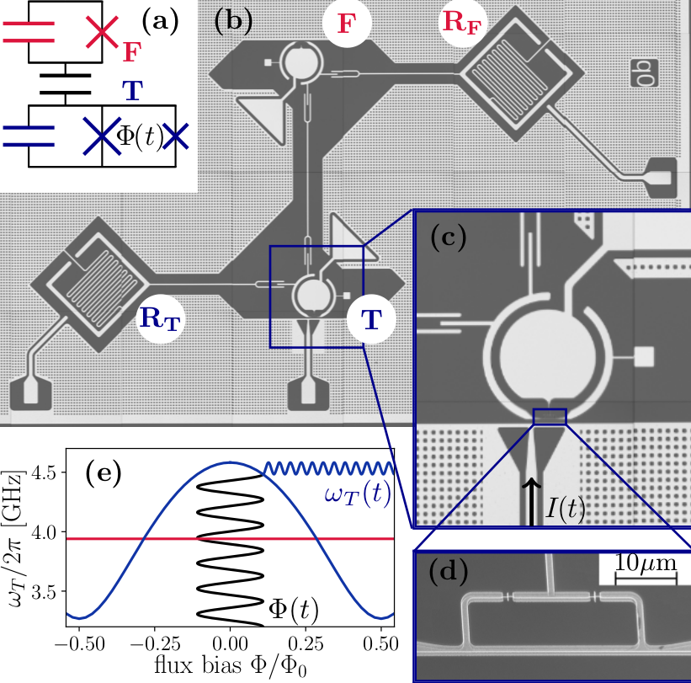


Parametric Entangling Gates
02
11
20
01
10
00

Slide 26
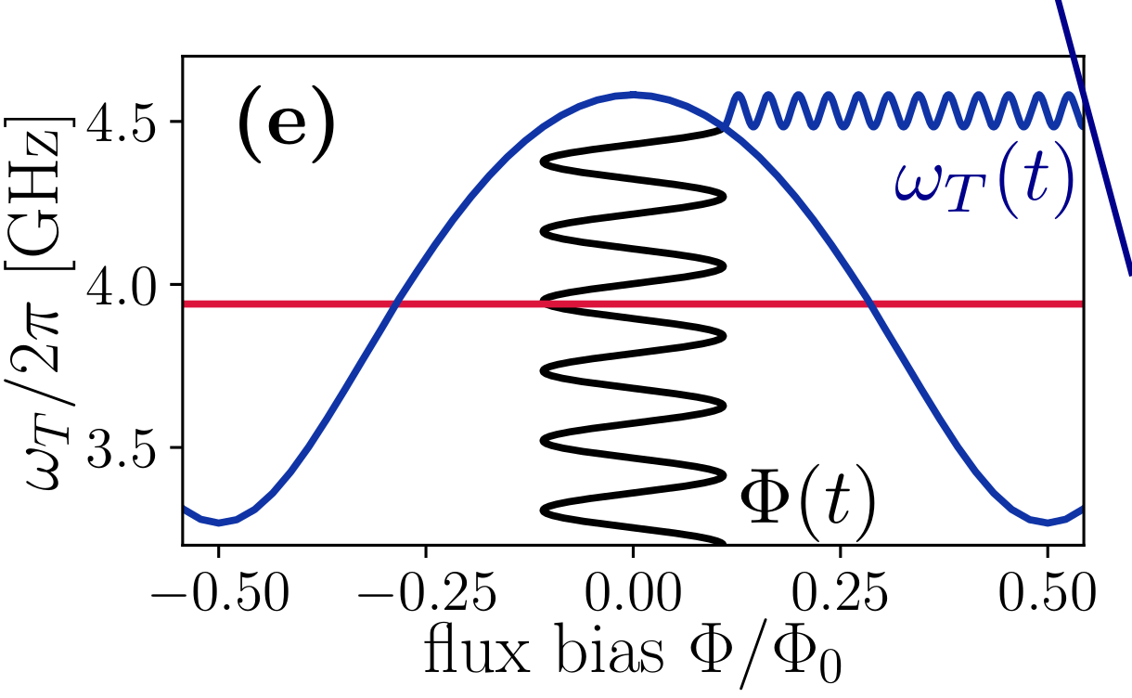
Parametric Entangling Gates
02
11
20
01
10
00

Slide 27
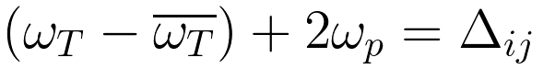
Parametric Entangling Gates
02
11
20
01
10
00
Resonance when
for some 𝚫 between levels i, j

Slide 28
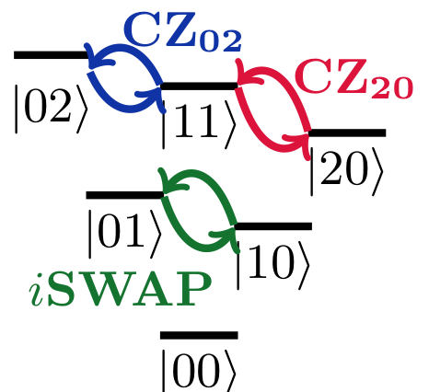
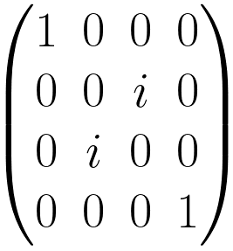
Parametric Entangling Gates
iSWAP =
Resonance when
for some 𝚫 between levels i, j

Slide 29
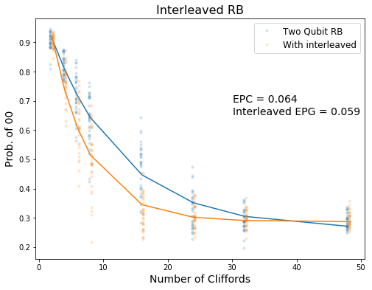
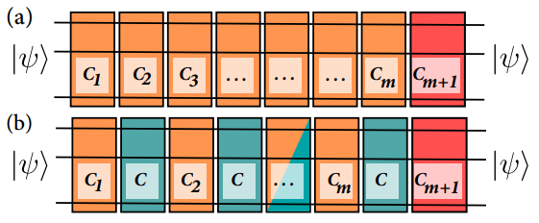
Randomized Benchmarking
Image from Magesan
Interleaved RB
A. Run sequences of 2Q Cliffords
B. Run sequences with gate C interleaved
Attempt to isolate the infidelity due to C
2Q gate type | Avg error per 2Q gate
iSwap | 5.9%
CZ₀₂ | 8.5%
CZ₂₀ | 8.7%
Magesan arXiv:1203.4550v2
Notes:
Clifford group generared by: CZ, H, PHASE(pi/2)
Clifford group is not a universal set and can be simulated efficiently on a classical computer

Slide 30
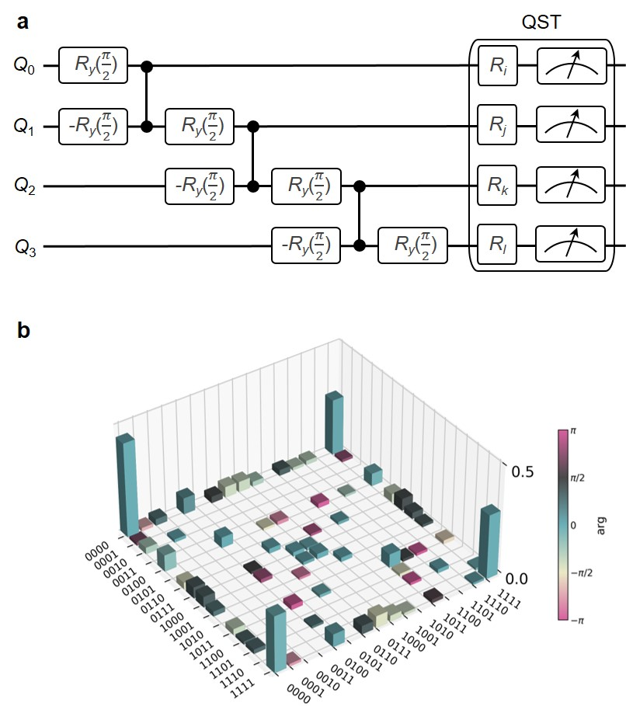
4 qubit entangled state verification
Quantum Circuit
Quantum State Tomography
Fidelity of 79%

Slide 31

Quil and the Quantum Abstract Machine
A hybrid classical/quantum programming model.
Notes:
Thank Will
Intro to Robert
Quil is an instruction language for a very broad class of quantum machines.

Slide 32
FSM & QAM
FSM
QAM
Classic Bits 0 and 1 encode the state
Universal Gate Sets
NOT + AND
NOT + OR
AND + XOR
…
Execution state (next instruction)
Qubits |0〉and |1〉
Universal Quantum Gate Set
CNOT + Single Qubit Gates
Classic Bits 0 and 1 encode the state
Universal Gate Sets
NOT + AND
NOT + OR
AND + XOR
…
Execution state (next instruction)

Slide 33
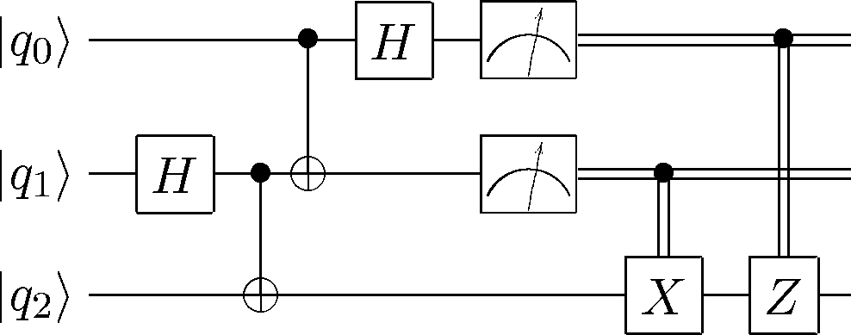
Quil is portable and hybrid.
Notes:
Quil is a classical/quantum hybrid algorithm, and I’d like to motivate that with an example.
This is the standard quantum teleportation algorithm you’d find within the first few lectures on QC.
It has the standard bits—unitary matrices and measurements—but on the right, we have this funny business with bits. Where do they go? What can we do with them?
Let’s look at the underlying formalism to Quil.

Slide 34
The Quil Programming Model
Targets a Quantum Abstract Machine (QAM) > Quil is the instruction language and is how you interact with the machine > It is a syntax for representing state transitions.
Notes:
Quil is an instruction language for an abstract state machine.
The abstract state machine has a set of states, and corresponding instructions to affect those states.

Slide 35
The Quil Programming Model
Targets a Quantum Abstract Machine (QAM) > Quil is the instruction language and is how you interact with the machine > It is a syntax for representing state transitions.
Ψ: Quantum state (qubits) → quantum instructions C: Classical state (bits) → classical and measurement instructions κ: Execution state (program)→ control instructions (e.g., jumps)
# Quil Example
H 3
MEASURE 3 [4]
JUMP-WHEN @END [5]
.
.
.
Notes:
Here, we see the three principal states of the QAM.
Quantum state, which is affected primarily by a set of gates
Classical state, which is affected by classical instructions, as well as measurement, which is the bridge between quantum and classical data
Execution state, which is the state of the control of the program. This is affected by jump-like or loop-like instructions.
On the right we see an example Quil program with sample instructions from each of these three classes. Let’s step through it.

Slide 36
The Quil Programming Model
Targets a Quantum Abstract Machine (QAM) > Quil is the instruction language and is how you interact with the machine > It is a syntax for representing state transitions.
Ψ: Quantum state (qubits) → quantum instructions C: Classical state (bits) → classical and measurement instructions κ: Execution state (program)→ control instructions (e.g., jumps)
# Quil Example
H 3
MEASURE 3 [4]
JUMP-WHEN @END [5]
.
.
.
0. Initialize into zero states
QAM: Ψ₀, C₀, κ₀
1. Hadamard on
qubit 3
Ψ₁, C₀, κ₁
Notes:
The first instruction is a hadamard on q 3, which of course will bring q 3 into the plus state.
The execution state is also trivially affected since we have to move one instruction down the sequence.

Slide 37
The Quil Programming Model
Targets a Quantum Abstract Machine (QAM) > Quil is the instruction language and is how you interact with the machine > It is a syntax for representing state transitions.
Ψ: Quantum state (qubits) → quantum instructions C: Classical state (bits) → classical and measurement instructions κ: Execution state (program)→ control instructions (e.g., jumps)
# Quil Example
H 3
MEASURE 3 [4]
JUMP-WHEN @END [5]
.
.
.
0. Initialize into zero states
QAM: Ψ₀, C₀, κ₀
1. Hadamard on
qubit 3
Outcome 0
Ψ₂, C₀, κ₂
Ψ₁, C₀, κ₁
Outcome 1
2. Measure qubit 3
into bit #4
Ψ₃, C₁, κ₂
Notes:
The next instruction, probably my favorite, has the most interesting effect.
It says to measure qubit 3, and deposit it into bit number 4. The brackets indicate classical memory.
It changes both the quantum state and classical state simultaneously.
Since measurement is non-deterministic, our possible states branch depending on whether we measure 0 or 1.
In the case we measure 0, then our classical state, in this case, does not change.

Slide 38
The Quil Programming Model
Targets a Quantum Abstract Machine (QAM) > Quil is the instruction language and is how you interact with the machine > It is a syntax for representing state transitions.
Ψ: Quantum state (qubits) → quantum instructions C: Classical state (bits) → classical and measurement instructions κ: Execution state (program)→ control instructions (e.g., jumps)
# Quil Example
H 3
MEASURE 3 [4]
JUMP-WHEN @END [5]
.
.
.
0. Initialize into zero states
QAM: Ψ₀, C₀, κ₀
1. Hadamard on
qubit 3
Outcome 0
3. Jump to end of program
if bit #5 is TRUE
Ψ₂, C₀, κ₂
Ψ₁, C₀, κ₁
Ψ₂, C₀, κ₃
Outcome 1
...
Ψ₃, C₁, κ₂
...
2. Measure qubit 3
into bit #4
...
Notes:
The last instruction is a JUMP. It allows us to jump anywhere in the program, conditional on a bit in classical memory.
We will see later how this helps us express some traditional circuit notation.
For those familiar, kappa is similar to a CPU’s “program counter”, and the program counter is changed depending on bit number 5.
The state machine model of Quil and the QAM is very helpful for basic understanding of how the language works. But lets turn to how it’s used in a real hybrid computation.

Slide 39
Interacting with a Classical Computer
> The Quantum Abstract Machine has a shared classical state. > The QAM becomes a practical device with this shared state. > Classical computers can take over with classical/quantum synchronization.
Quantum Processor
H 0
CNOT 0 1
MEASURE 0 [7]
MEASURE 1 [3]
WAIT
Classical Processor
if C[3] + C[7] == 2:
theta = 3*pi/7
...
continue_from_wait()
...
C: Classical Shared Memory (bits)
0
0
0
1
0
0
1
0
0
0
0
0
0
0
0
0

Slide 40
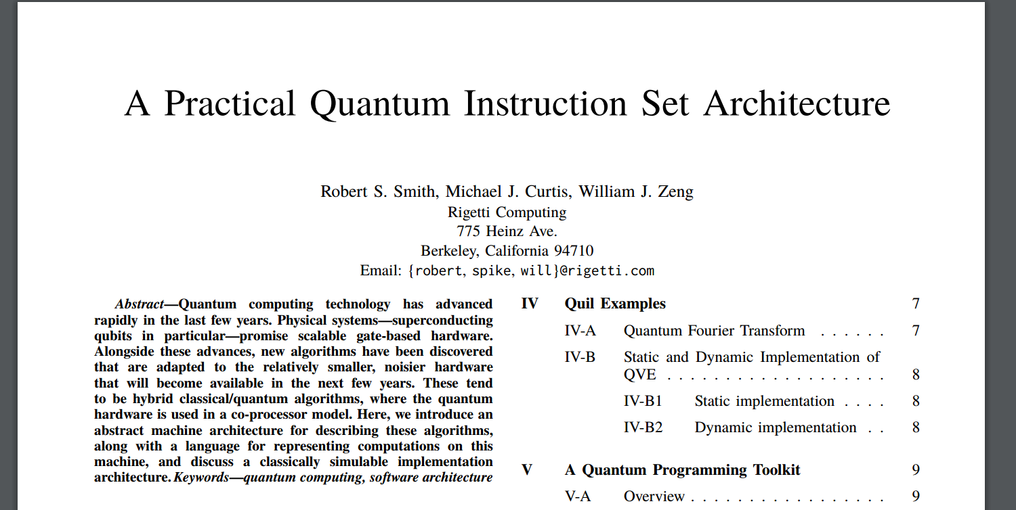
Formal Details: The Quil White Paper
arXiv:1608.03355

Slide 41
Quantum Teleportation in Quil
[0]
DEFCIRCUIT TELEPORT A q B:
# Bell pair
H A
CNOT A B
# Teleport
CNOT q A
H q
MEASURE q [0]
MEASURE A [1]
# Classically communicate measurements
JUMP-UNLESS @SKIP [1]
X B
LABEL @SKIP
JUMP-UNLESS @END [0]
Z B
LABEL @END
# If Alice’s qubits are 0 and 1
# and Bob’s is 5
TELEPORT 0 1 5
Alice’s ancilla q
[1]
Alice A
Bob B
Notes:
I’d like to go back to our original example of quantum teleportation now, and show how this gets translated into Quil.
The QT circuit has three main portions: bell pair construction, teleportation, and communication of classical results.
The bell pair is straightforward. It’s a hadamard and a CNOT
The teleportation consists of another bell pair construction plus some measurement. I’ve annotated this circuit with [0] and [1] to denote where the results get stored in classical memory.
The communication of the classical results is the interesting bit. We replace the notion of a “classically controlled gate” with classical control flow. This is a generalization of what’s capable in circuit notation.
Lastly, I’ll touch briefly on the fact that Quil also acts as a sort of macro-assembler. DEFCIRCUIT is a way to make reusable functionality within Quil. We can see at the bottom an instantiation of this circuit with Alice’s qubits 0 and 1, and Bob’s qubit 5

Slide 42
Teleportation Truth Table
Bell State: |00〉+ |11〉
Ancilla: α|0〉+ β |1〉
State |A B q〉 | CNOT q A | H q | Classic C-X A B | Classic C-Z q B
α |000〉 | α |000〉 | |00〉_{Aq} (α|0〉+ β |1〉)_{B} | [0, 0]_{Aq}; α|0〉+ β |1〉 | α|0〉+ β |1〉
β |001〉 | β |101〉 | |11〉_{Aq} (α|1〉- β |0〉)_{B} | [1, 1]_{Aq}; α|0〉- β |1〉 | α|0〉+ β |1〉
α |110〉 | α |110〉 | |10〉_{Aq} (α|1〉+ β |0〉)_{B} | [1, 0]_{Aq}; α|0〉+ β |1〉 | α|0〉+ β |1〉
β |111〉 | β |011〉 | |01〉_{Aq} (α|0〉- β |1〉)_{B} | [0, 1]_{Aq}; α|0〉- β |1〉 | α|0〉+ β |1〉

Slide 43
pyQuil generates Quil
from pyquil.gates import X, CNOT, H, Z, RX, I
from pyquil.api import QVMConnection
from pyquil.quil import Program
import numpy as np
qvm = QVMConnection()
alice_register = 0
ancilla_register = 1
flip_correction_branch = Program(X(1))
phase_correction_branch = Program(Z(1))
prog = (Program()
.inst(H(0))
.inst(CNOT(0, 1))
.inst(RX(0.2 * np.pi, 2))
.inst(CNOT(2, 0))
.inst(H(2))
.measure(0, alice_register)
.measure(2, ancilla_register)
.if_then(alice_register, flip_correction_branch)
.if_then(ancilla_register, phase_correction_branch))
qvm.run_and_measure(prog, list(prog.get_qubits()), trials=10)
H 0 CNOT 0 1 RX(pi/5) 2 CNOT 2 0 H 2 MEASURE 0 [0] MEASURE 2 [1] JUMP-WHEN @THEN1 [0] JUMP @END2 LABEL @THEN1 X 1 LABEL @END2 JUMP-WHEN @THEN5 [1] JUMP @END6 LABEL @THEN5 Z 1 LABEL @END6

Slide 44
Hybrid Quantum Computing
CPU
QPU
Classical computation sets up and stores model, uses quantum data for expensive sub-algorithm
QPU operates on entire parameter space to get the search direction
Perform quantum measurement, deposit update direction into memory
Prepare expensive function call
Load data onto qubits
Select “hyper” parameters
DEFCIRCUIT QAOA(%gamma, %beta)
RY(pi/2) 0 RY(pi/2) 1 CNOT 0 1 RZ(%gamma) 1 CNOT 0 1 RX(%beta) 0 RX(%beta + pi/2) 1
MEASURE 0 [0]
MEASURE 1 [1]
Repeat for accuracy
Prepare quantum data
Measure update
into memory
Analyze QPU results
Notes:
Hybrid computing interplay to optimize over large data-sets
CPU is for hyper parameter optimization
QPU is for getting a better search direction/better gradient/ non-greedy function call/ over large data-set.

Slide 45
Compilation
> Quil qubit labels to physical qubits
> Routing to deal with two-qubit gates
> Optimization over noise and errors
DEVELOPMENT: pyQuil
QUANTUM INSTRUCTION LANGUAGE: Quil
> Compilation into the natural gate set
> Rotation Decomposition
Allocation & Routing
Unitary Compilation
Scheduling
QUANTUM VIRTUAL MACHINE / QUANTUM COMPUTER
> Scheduling into microcode

Slide 46
Some useful tools
QVM with up to 37 qubits (on AWS)
Can simulate arbitrary 1 & 2 qubit noise by definition of Kraus maps
def damping_channel(p=.01): damping_op = np.array([[0, sqrt(p)], [0, 0 ]]) residual_kraus = np.diag([1, sqrt(1-p)]) return [residual_kraus, damping_op]
# overload identity gate I on qc 0 with p=1% damping probability p.define_noisy_gate("I", [0], damping_channel(0.01))
Compilation layer
Specify arbitrary circuit and compile to natural gate set
Compression optimizations build in
Simple layout optimization: Quantum Circuit to Chip Topology
E.g. compiled RB circuit to identity
Simple prototyping before requesting QPU
from pyquil.api import QVMConnection
cxn = QVMConnection()
cxn.run_and_measure(prog, ...)
from pyquil.api import QPUConnection
cxn = QPUConnection(“19Q-Acorn”)
cxn.run_and_measure(prog, ...)

Slide 47

NISQ
Applications

Slide 48
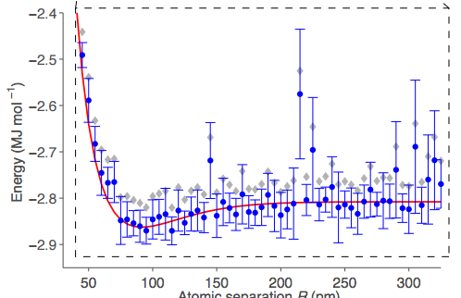
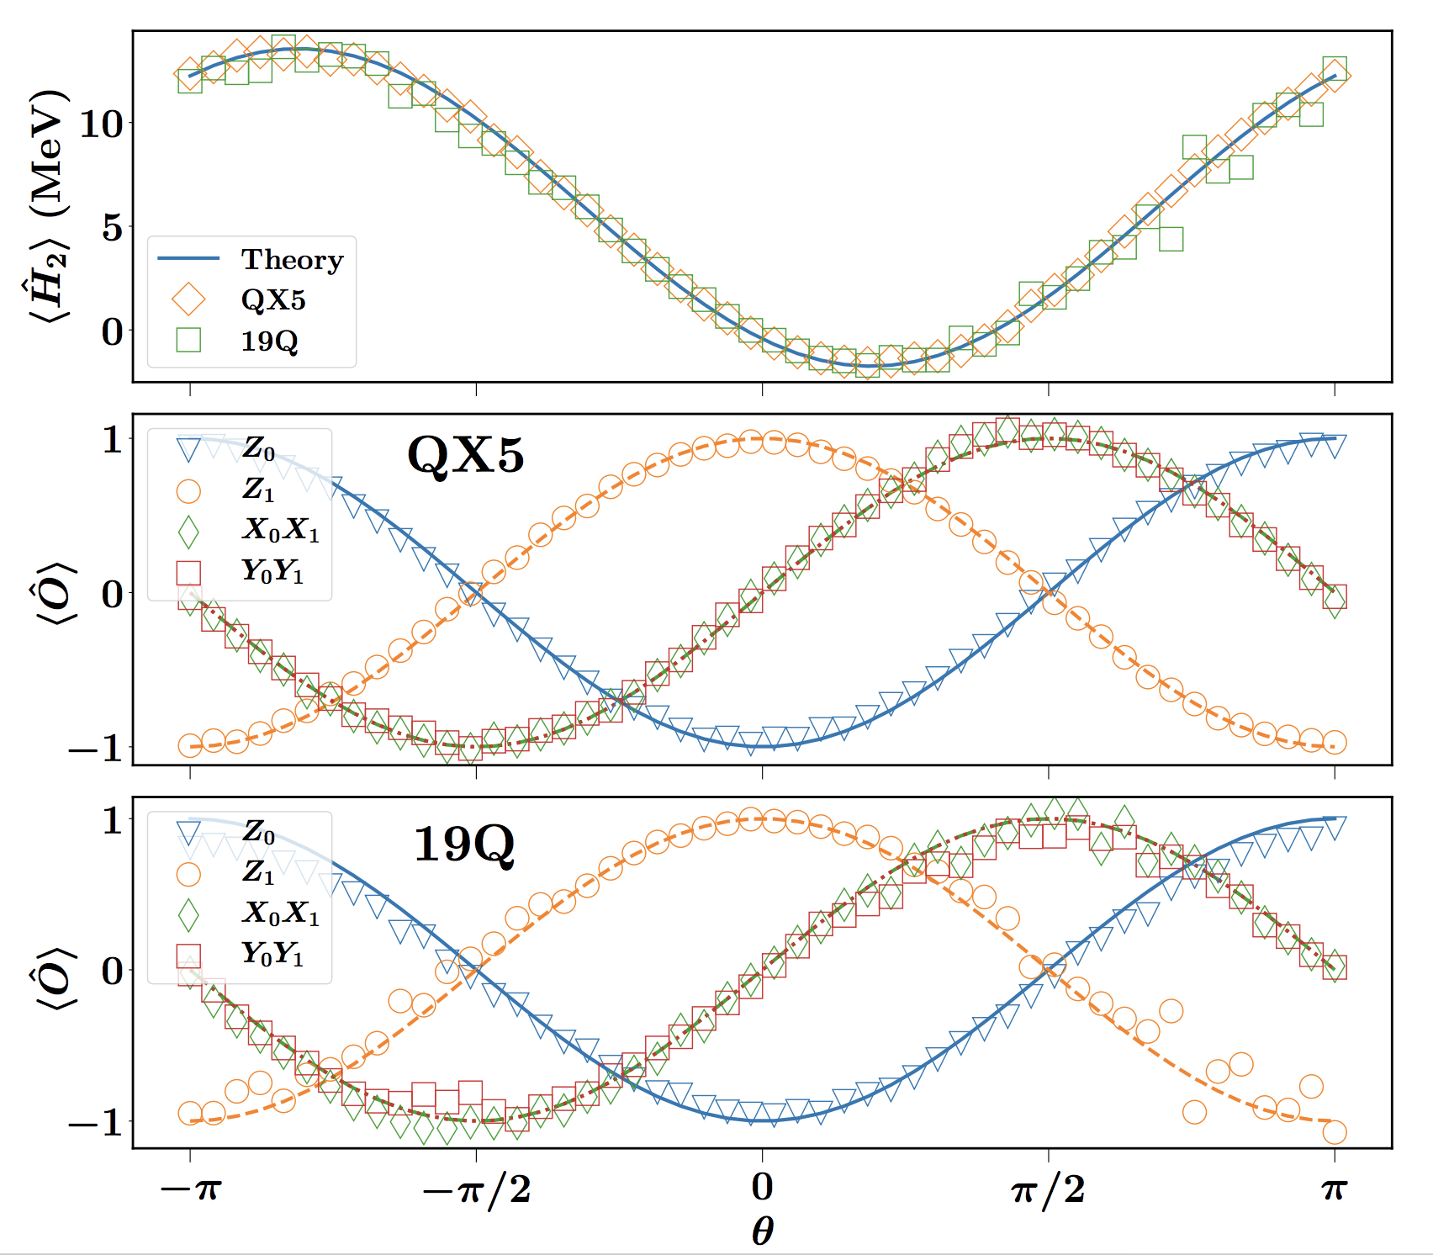
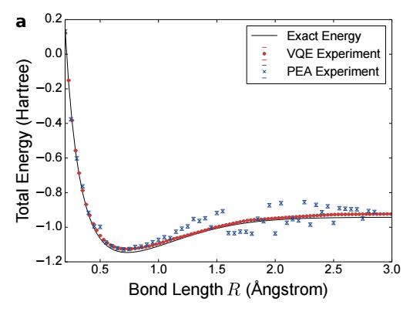
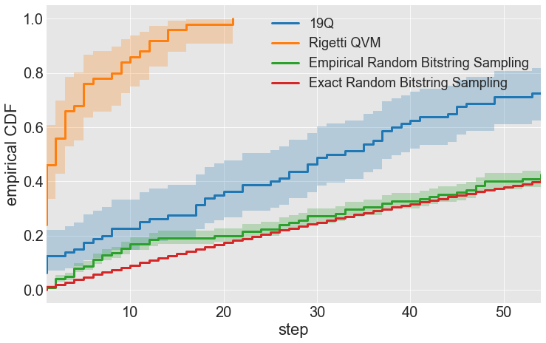
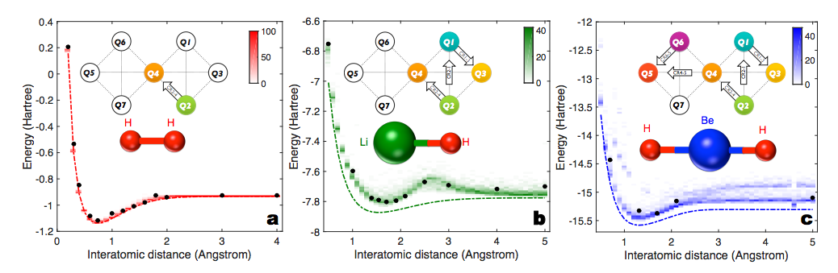
NISQ - Near-term Intermediate Scale Quantum
Preskill, arXiv:1801.00862
Dumitrescu et al. [ORNL]
On IBM & Rigetti Hardware
arXiv:1801.03897
Peruzzo et al. [Harvard Group] Nature Comm. 5,4213 (2014)
O’Malley et al. [Google]
Phys. Rev. X 6, 031007 (2016)
Otterbach et al. [Rigetti]
arXiv:1712.05771
Kandala et al. [IBM]
Nature 549, 242 (2017)

Slide 49
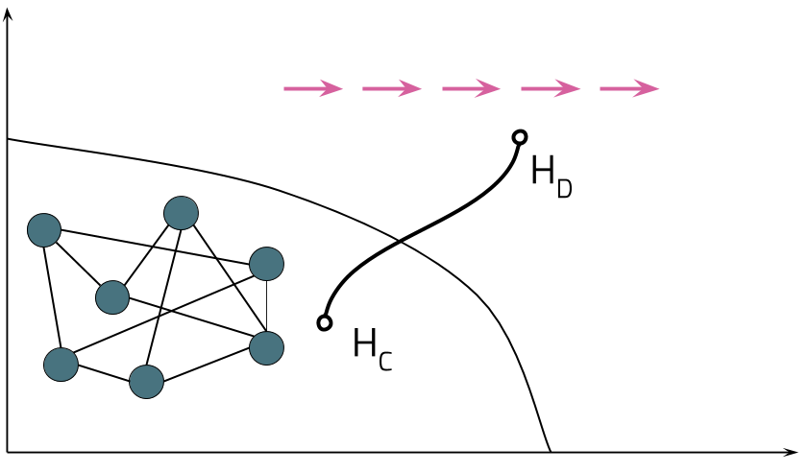

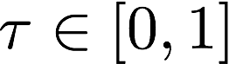
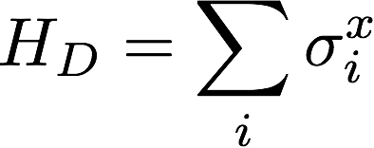

QAOA - Quantum Approximate Optimization Algorithm
Motivated through Adiabatic Quantum Computing
Encode solution to hard NP-complete problem in ground-state of H_{C}
Start at easy to prepare initial state with Hamiltonian H_{D}
Typical examples are graph problems
Traveling Salesman
Portfolio Optimization (Knapsack)
N-SAT
Sudoku (Exact Cover)

Slide 50

Trotterization
Gate model of AQC (Farhi, Goldstone, Gutman, arxiv:1411.4028)
Angles β_{p}, ɣ_{p} need not be small
Theory for p→∞ is exact; in practice small p is already good
No specification on how to find optimal β_{p}, ɣ_{p}

Slide 51

Example: Maxcut
“Maximize disagreement on a colored graph”
Score 0
Score 0
Score+1
4-node “ring of disagrees”
Score 0
Score 2
Score 2
Score 4 (max)

Slide 52


Example: Maxcut
Initial state is ground state of H_{D} :
Run the QAOA prescription:
Intuitively: Superposition of bitstring configurations
| β, ɣ〉
√p₁
√p₂
√p₁₆

Slide 53
Probability distributions over bit strings
Cost | Choice | β₁, ɣ₁ 〉 | Choice | β₂, ɣ₂ 〉 | Choice | β₃, ɣ₃ 〉
0 | p = 0.1 | p = 0.01 | p = 0.2
2 | p = 0.3 | p = 0.15 | p = 0.01
2 | p = 0.05 | p = 0.2 | p = 0.0
4 | p = 0.01 | p = 0.51 | p = 0.25

Slide 54




(Weighted) Maxcut as Clustering
Graph encoding
Hamiltonian
QAOA
Euclidean distance
Measurement in computational basis

Slide 55
When are we done?
CPU
QPU
Create Quil with selected parameters
Compile to hardware instructions
Entry
Select angles
Play instructions
Output
Evaluate termination criterion
Analyze Samples
& Evaluate real valued objective function
Measure
&
Record Sample

Slide 56



Objective Function
Loss/Reward Function:
“quality of a sampled bit-string”
Objective Function
Extreme values
Mean
…
Find the optimum of objective:
No easy access to gradients, need derivative free methods
Nelder-Mead
Bayesian Methods
...
Image from https://datagraver.com/case/world-temperature-anomalies-for-februari-2016

Slide 57

Bayesian Optimization
Gaussian Process Prior of objective function

Slide 58

Bayesian Optimization
Gaussian Process Prior of objective function
Measure and update Prior

Slide 59

Bayesian Optimization
Gaussian Process Prior of objective function
Measure and update Prior
Choose next point to measure and update

Slide 60

Bayesian Optimization
Gaussian Process Prior of objective function
Measure and update Prior
Choose next point to measure and update
Again

Slide 61

Bayesian Optimization
Gaussian Process Prior of objective function
Measure and update Prior
Choose next point to measure and update
Again
…

Slide 62

Bayesian Optimization
Gaussian Process Prior of objective function
Measure and update Prior
Choose next point to measure and update
Again
…
…

Slide 63

That’s how it looks in practice
Fully Connected Graph for clustering
Noiseless Simulator (Rigetti QVM)
p=1 QAOA

Slide 64

That’s how it looks in practice
Fully Connected Graph for clustering
Noiseless Simulator (Rigetti QVM)
p=1 QAOA

Slide 65


Clustering on a 19-Q Chip
Chip topology requires smart gate sequence for QAOA to execute all gates on a vertex
Staggering gate applications according to edge-coloring

Slide 66

Clustering on a 19-Q Chip
Moderate coherence times
Moderate 2Q fidelities
Moderate readout fidelities
Demonstration with chip specific problem taylored to the topology
Overlap problem similar to VLSI design

Slide 67

Putting it all together
83 trial runs on the QPU
p=1 QAOA, i.e. single application of U and V
Algorithm finds the optimum most of the time
Calculate eCDF form the traces

Slide 68

Empirical performance
Success probability monotonically increases with number of steps.

Slide 69

Empirical performance
Success probability monotonically increases with number of steps.
Noise in 19Q has a significant impact on performance.

Slide 70
Empirical performance
Success probability monotonically increases with number of steps.
Noise in 19Q has a significant impact on performance.
Approach clearly outperforms random sampling.

Slide 71



Forest
Join our community Slack:
Find us on Github:
slack.rigetti.com
github.com/rigetticomputing
Sign-Up @ rigetti.com/forest QPU access @ rigetti.com/qpu-request

Slide 72

Thank you
More details in our pre-print arXiv: 1712.05771

Slide 73
Spare slides

Slide 74

15 years of exponential performance improvement
Trends in “modern” superconducting qubits:
> All (or mostly) RF control
> Dispersive readout
> 3D cavity resonators
M. Reagor thesis, 2015

Slide 75






Quantum Fourier Transform (QFT)
Discrete Fourier Transform (DFT)
Fourier conjugates (vectors)
Vector:
N is a power of two
Quantum Fourier Transform
Fourier conjugates p & q (state vectors)
State:
(Basis vectors explicit)
N is a power of two:
N=2^{n} with n qubits
Both:

Slide 76
Quantum Fourier Transform (QFT)
Quantum Fourier Transform
Is unitary ✔
Is faster than DFT
Is an important subroutine of other algorithms

Slide 77

Quantum Fourier Transform (QFT)
Quantum Fourier Transform
Is unitary ✔
Is faster than DFT
Is an important subroutine of other algorithms
Decimal labels
Binary labels

Slide 78

Quantum Fourier Transform (QFT)
Quantum Fourier Transform
Is unitary ✔
Is faster than DFT
Is an important subroutine of other algorithms
Decimal labels
Binary labels
Fact:

Slide 79

Quantum Fourier Transform (QFT)
Concrete example:

Slide 80
Quantum Fourier Transform (QFT)
Concrete example:

Slide 81







Quantum Fourier Transform (QFT)
Concrete example:

Slide 82

Quantum Fourier Transform (QFT)

Slide 83



Quantum Fourier Transform (QFT)

Slide 84


Quantum Fourier Transform (QFT)

Slide 85

Quantum Fourier Transform (QFT)

Slide 86


Quantum Fourier Transform (QFT)
Fast Fourier Transform:
Quantum Fourier Transform:

Slide 87

Quantum Fourier Transform (QFT)
Quantum Fourier Transform
Is unitary ✔
Is faster than Fast Fourier Transform
Is an important subroutine of other algorithms
Fast Fourier Transform:
Quantum Fourier Transform:
Caveats:
Can’t directly read out p_{k}
→ use as subroutine
State preparation of is inefficient
→ restricted to simple initial states

Slide 88
Quantum Fourier Transform (QFT)
Quantum Fourier Transform
Is unitary ✔
Is faster than Fast Fourier Transform
Is an important subroutine of other algorithms
Fast Fourier Transform:
Quantum Fourier Transform:
Caveats:
Can’t directly read out p_{k}
→ use as subroutine
State preparation of is inefficient
→ restricted to simple initial states
QFT descendants:
Phase estimation
Order finding
Prime number factorization

Slide 89

Proof of principle
Fixed
Prepare |0>
Readout
Tunable
Prepare |1>
Flux pulse (RF)
Sweep duration
Readout

Slide 90


Proof of principle
Fixed
Prepare |0>
Readout
Fixed
Prep |0>
RO
Vary
Wait
Tunable
Prepare |1>
Flux pulse (RF)
Sweep duration
Readout
Tunable
Prep |1>
Flux
Flux
RO

Slide 91
May 16
May 12
Proof of principle
Fixed
Prepare |0>
Readout
Fixed
Prep |0>
RO
Vary
Wait
Tunable
Prepare |1>
Flux pulse (RF)
Sweep duration
Readout
Tunable
Prep |1>
Flux
Flux
RO

Slide 92




Theory
Resonant frequencies
Effective couplings
Didier & Rigetti arXiv:1706.06566

Slide 93
Why do we need to schedule?
Quil has no notion of time or synchronization.
But time and synchronization are very important.
What are our options?
Give up;
Admit the physicists are better
“Program” with buttons and wires.
Include ad hoc
synchronization instructions
Extend Quil to “know” about time.
Compile Quil into some
temporal representation
Add machine-specific directives.
Pros:
Maximal control
Cons:
Difficult to reason about
Nixes the idea of an abstraction
Difficult to automate
Have to think about hardware
Pros:
Directly addresses the issue
Still an abstract framework
Cons:
Extremely complicated!
Difficult to reason about
Not easily extensible
Hard to implement
Loses the “essence”
Pros:
Remains abstract
Adds control as necessary
Extensible!
Keeps Quil “clean”
Cons:
Compilation is more difficult
Performance characterization is machine-specific

Slide 94

Parametric entangling gates
iSWAP
CZ₀₂ & CZ₂₀
Theory
Experiment
Theory
Experiment
Theory
Caldwell & Rigetti arXiv:1706.06562

Slide 95

Parametric entangling gates
Experiment
Theory
Caldwell & Rigetti arXiv:1706.06562

Slide 96

Parametric entangling gates
Reagor & Rigetti arXiv:1706.06570

Slide 97



Forest 1.0
June 20
Integration
Demonstration
Theory

Slide 98



What is a quantum computer?
Machine that natively executes unitary operations on quantum systems
Generalizes universal classical computer
Benefits from inherent size of Hilbert spaces
Better performance on notable hard problems
Classical state
Quantum state

Slide 99
What is a quantum computer?
Machine that natively executes unitary operations on quantum systems
Generalizes universal classical computer
Benefits from inherent size of Hilbert spaces
Better performance on notable hard problems
+1 qubit = 2x compute or memory
Addressable problem size
Energy efficiency
Classical state
Quantum state

Slide 100
What is a quantum computer?
Machine that natively executes unitary operations on quantum systems
Generalizes universal classical computer
Benefits from inherent size of Hilbert spaces
Better performance on notable hard problems
+1 qubit = 2x compute or memory
Addressable problem size
Energy efficiency
Interesting properties
Fully reversible
No copying an arbitrary state
Non-deterministic state readout
Classical state
Quantum state

Slide 101

One-qubit quantum state
Lives on the surface of the Bloch sphere

Slide 102


Multi-qubit state
Arbitrary state
Larger Hilbert space is tensor product of smaller ones

Slide 103
Multi-qubit state
Arbitrary state
Basis states:

Slide 104

Multi-qubit state
Arbitrary state
Basis states:
General states:
(entanglement)

Slide 105


Controlling a quantum state
“Machine that natively executes unitary operations on quantum systems”
Unitaries are rotations
Qubit frequency f_{q}
Qubit precesses in xy (complex) plane at f_{q}
X and Y rotations driven with external fields
X and Y rotations by driving
Z rotations by waiting

